Slide 1
Digital Image Processing (CSE405)
Introduction
Md. Ferdous
Lecturer, Dept. of CSE, BSMRSTU

Slide 2
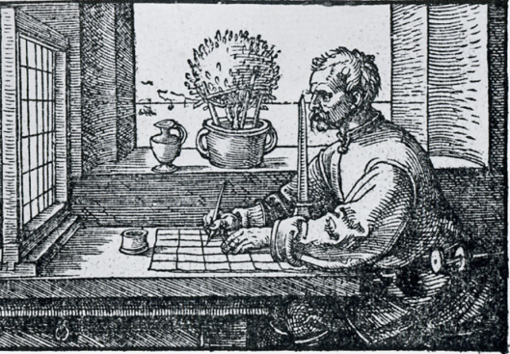


Imaging
X
y
X
y
[Albrecht Dürer, 1525]
Image: a visual representation in form of a function f (x,y)
where f is related to the brightness (or color) at point (x,y)
Most images are defined over a rectangle
Continuous in amplitude and space
Digital Image Processing: Bernd Girod, © 2013-2019 Stanford University -- Introduction 2

Slide 3
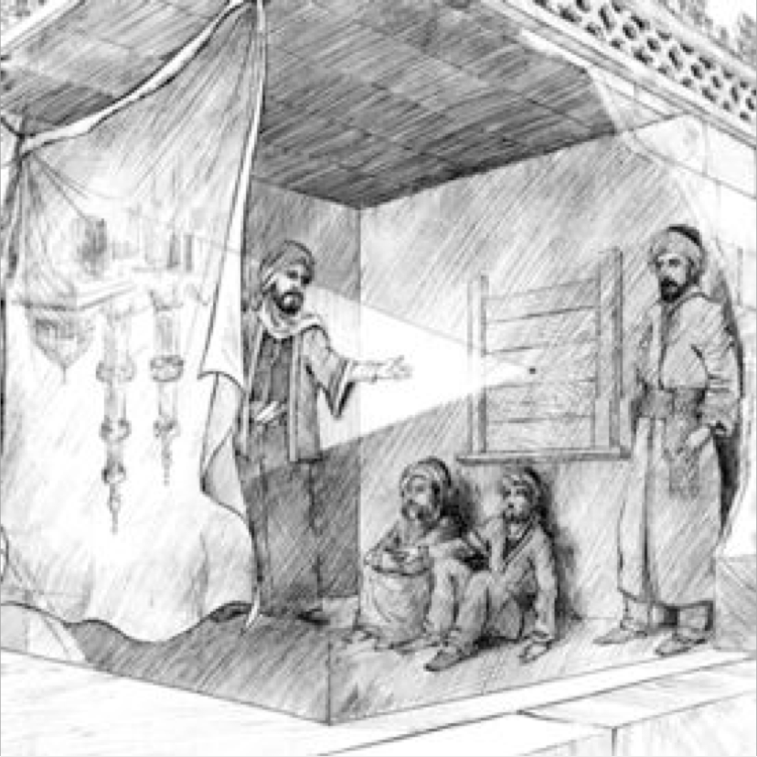
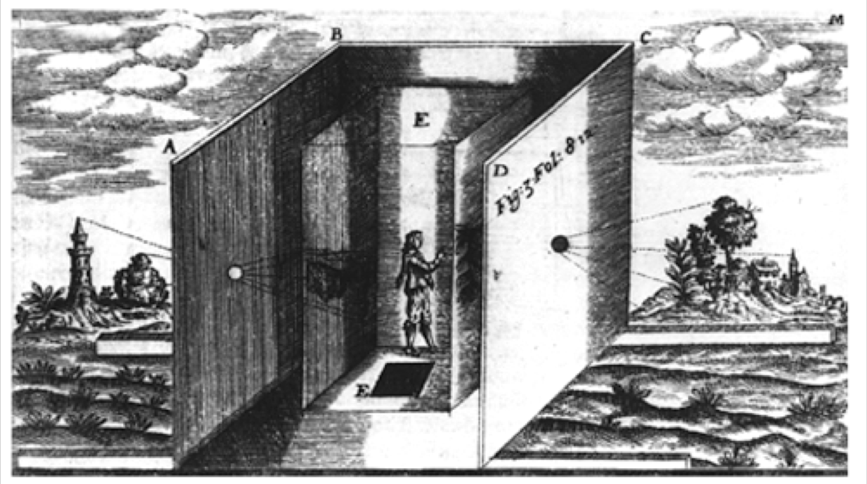
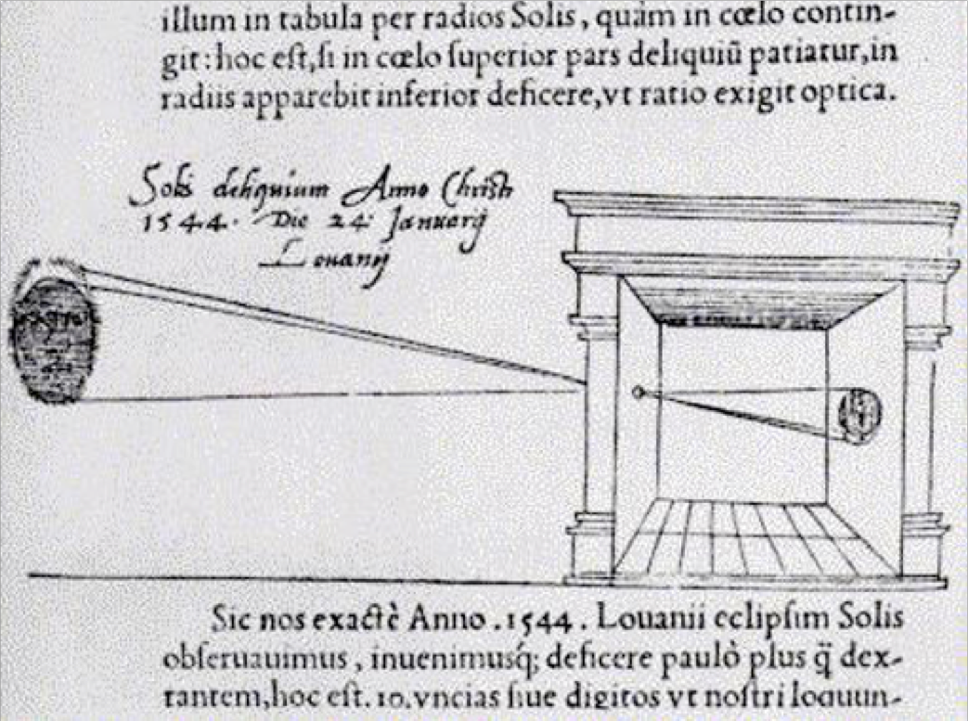
Imaging
Dark chamber with lenses [Kircher 1646]
Image: a visual representation in form of a function f (x,y)
where f is related to the brightness (or color) at point (x,y)
Most images are defined over a rectangle
Continuous in amplitude and space

Slide 4
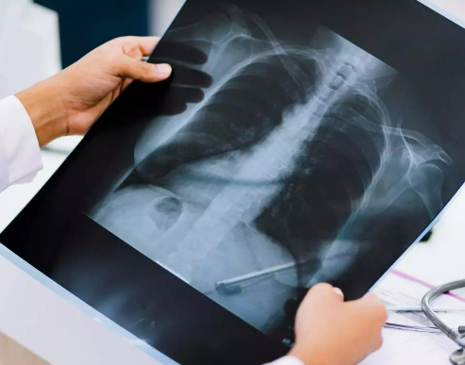
Analog Image
An image can be understood as a 2D light intensity function f(x,y) where:
x and y are spatial coordinates
The value of f at any point (x, y) is proportional to the brightness or gray value of the image at that point
Cannot be stored as such on a digital computer.

Slide 5
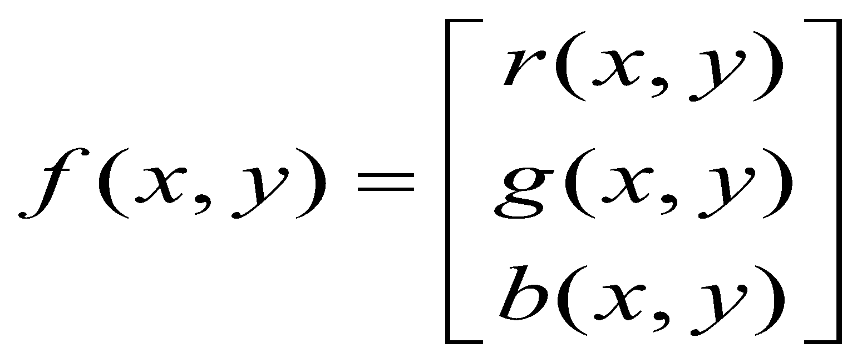
What is an image?
We can think of an image as a function, f, from R² to R:
f( x, y ) gives the intensity at position ( x, y )
Realistically, we expect the image only to be defined over a rectangle, with a finite range:
f: [a,b]x[c,d] 🡪 [0,1]
A color image is just three functions pasted together. We can write this as a “vector-valued” function:
Notes:
As opposed to [0..255]

Slide 6
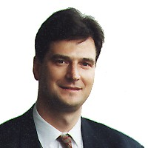






Digital Images and Pixels
Digital image: discrete samples f [x,y] representing continuous image f (x,y)
Each element of the 2-d array f [x,y] is called a pixel or pel
(from “picture element“)
200x200
100x100
50x50
25x25

Slide 7

Digital Image
A digitized image is one in which:
Spatial and grayscale values have been made discrete.
Intensities measured across a regularly spaced grid in x and y directions are sampled to
8 bits (256 values) per point for black and white,
3x8 bits per point for color images.
Stored as a 2D arrays of gray-level values. The array elements are called pixels and identified by their x, y coordinates.

Slide 8
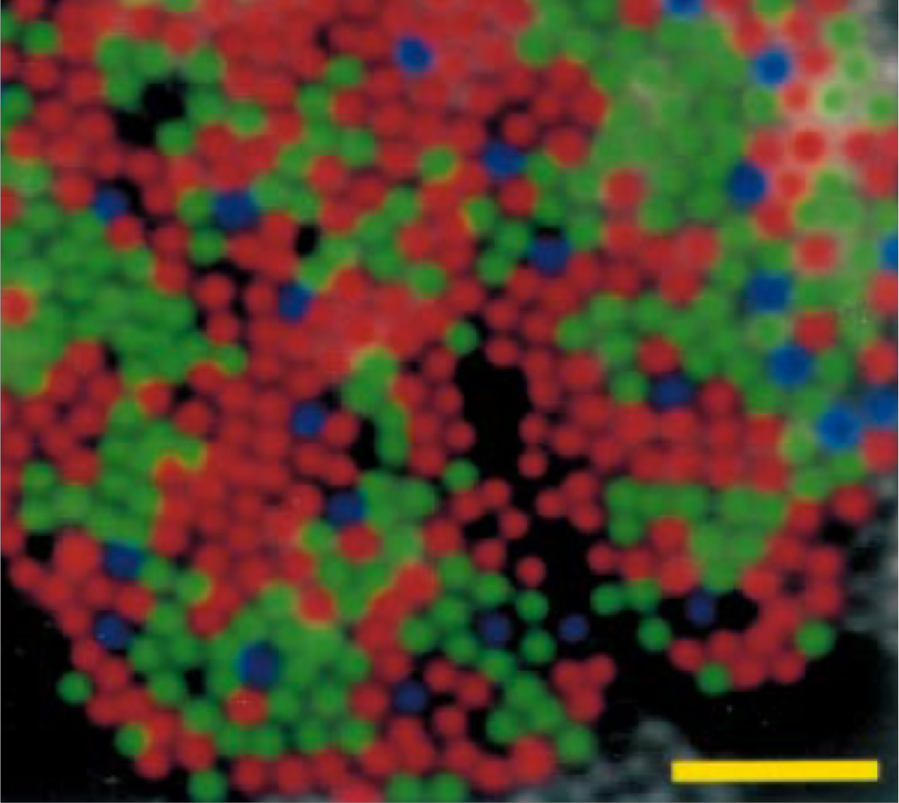
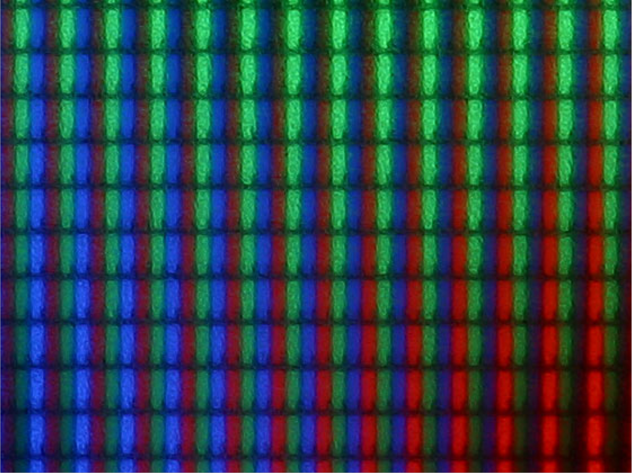


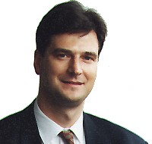




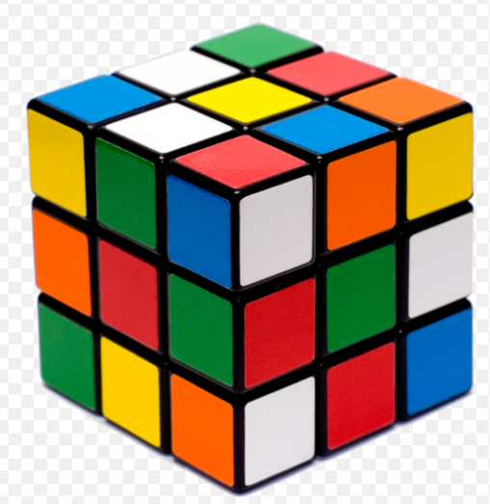
Color Components
Monochrome image
R[x,y] = G[x,y] = B[x,y]
20 μm
Red R[x,y]
Green G[x,y]
Blue B[x,y]

Slide 9
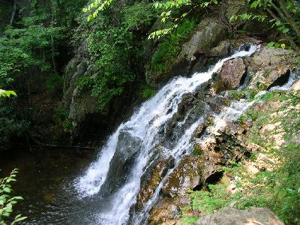

What is a Digital Image? (cont…)
Common image formats include:
1 sample per point (B&W or Grayscale)
3 samples per point (Red, Green, and Blue)
4 samples per point (Red, Green, Blue, and “Alpha”, a.k.a. Opacity)
For most of this course we will focus on grey-scale images

Slide 10

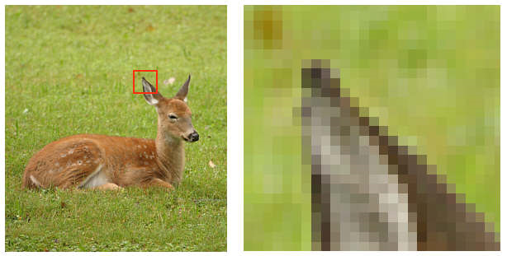

What is a Digital Image? (cont…)
Pixel values typically represent gray levels, colours, heights, opacities etc
Remember digitization implies that a digital image is an approximation of a real scene
Images taken from Gonzalez & Woods, Digital Image Processing (2002)
1 pixel

Slide 11
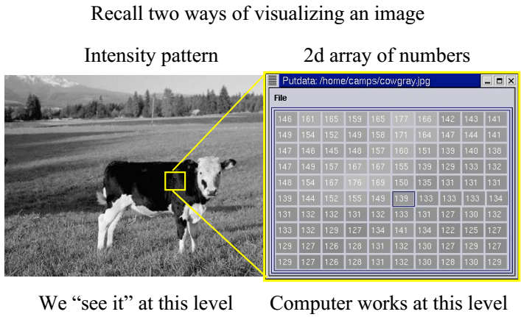
Visualizing Image

Slide 12
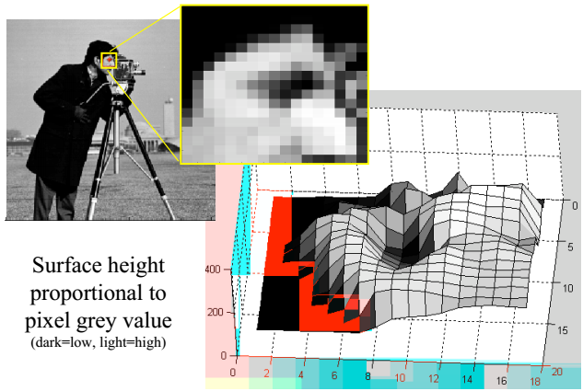
Images as Surfaces

Slide 13
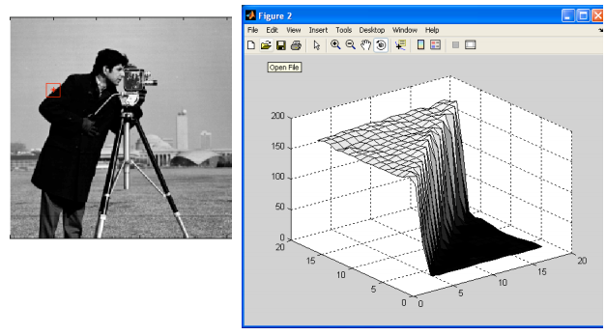
Images as Surfaces

Slide 14
What is Digital Image Processing?
Digital image processing focuses on two major tasks
Improvement of pictorial information for human interpretation
Processing of image data for storage, transmission and representation for autonomous machine perception
Some argument about where image processing ends and fields such as image analysis and computer vision start

Slide 15
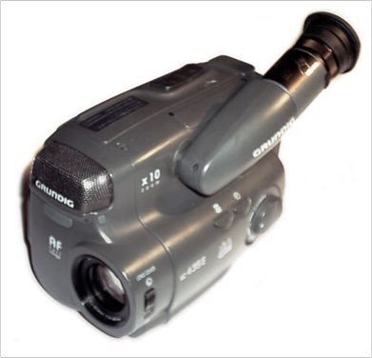
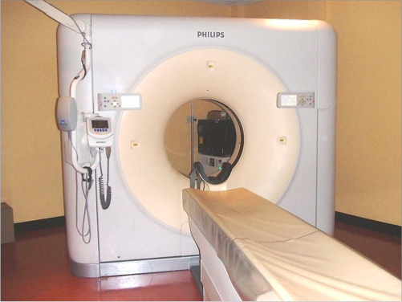
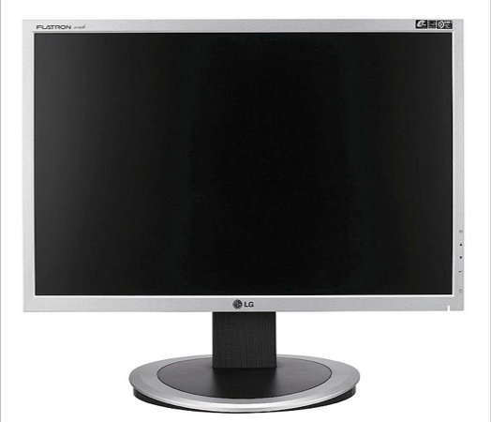

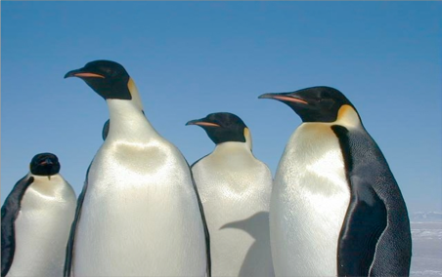
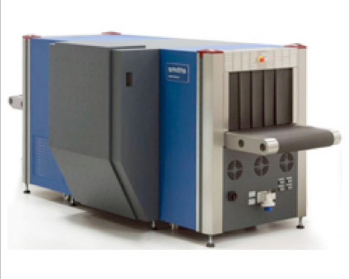
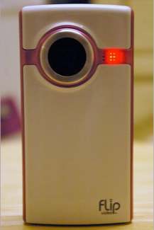
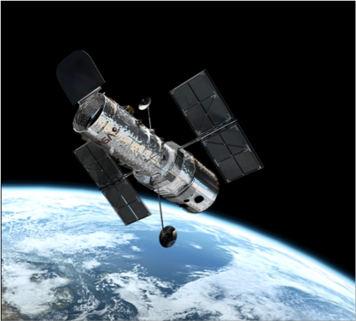

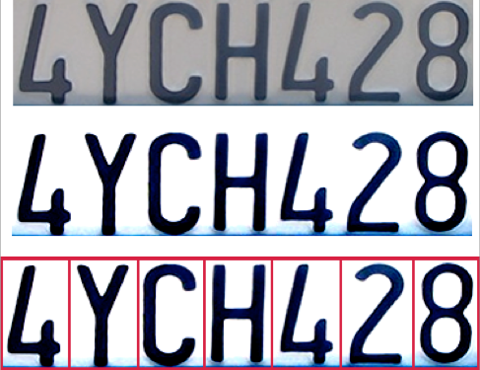
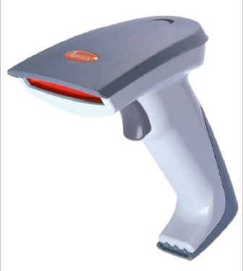
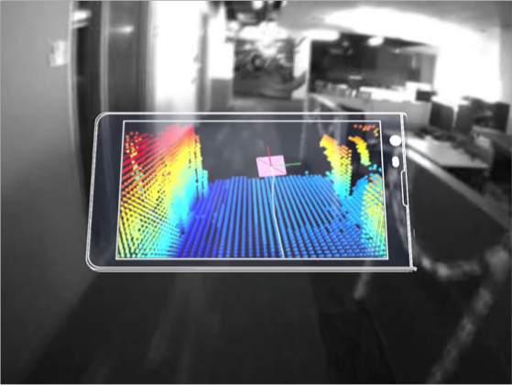
Why do we process images?
Acquire an image
Correct aperture and color balance
Reconstruct image from projections
Prepare for display or printing
Adjust image size
Color mapping, gamma-correction, halftoning
Facilitate picture storage and transmission
Efficiently store an image in a digital camera
Send an image from space
Enhance and restore images
Touch up personal photos
Color enhancement for security screening
Extract information from images
Read 2-d bar codes
Character recognition
Depth estimation
Many more ... image processing is ubiquitous

Slide 16
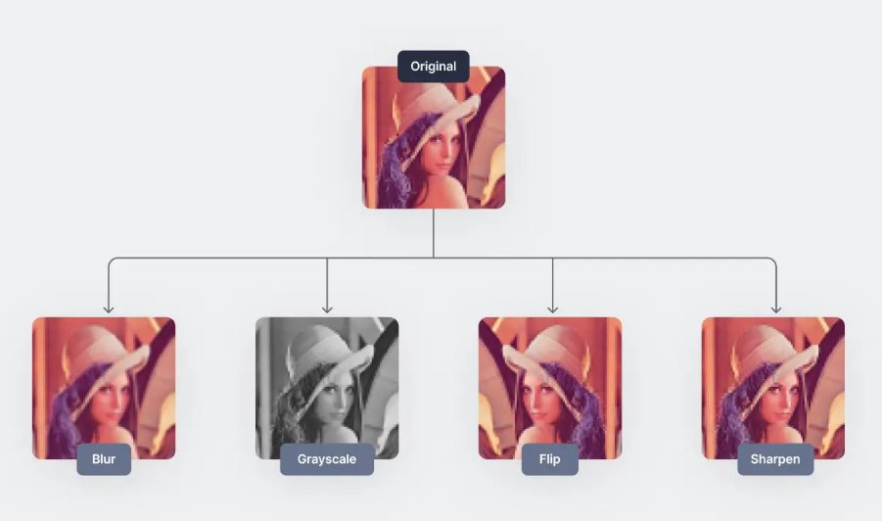
Have you done it?
Examples of typical image processing operations

Slide 17
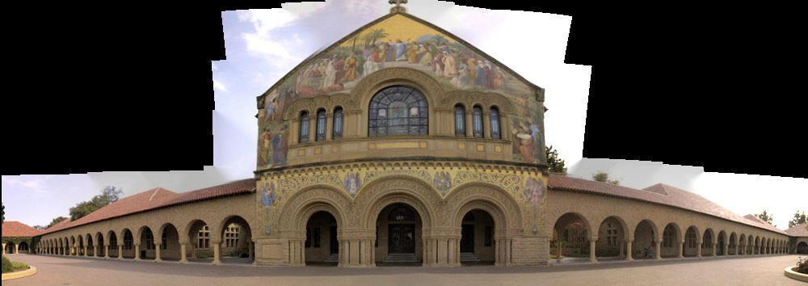
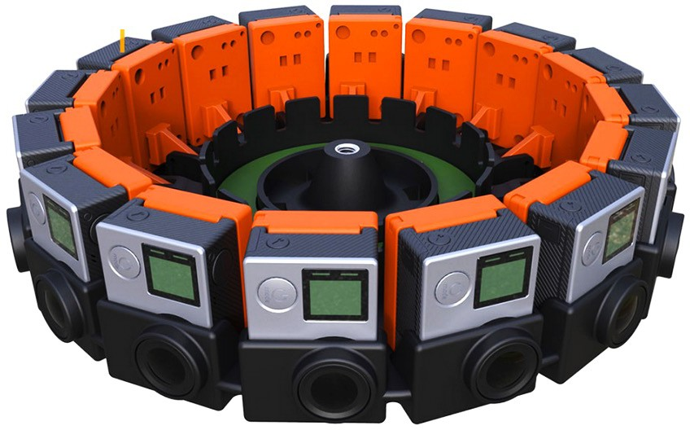
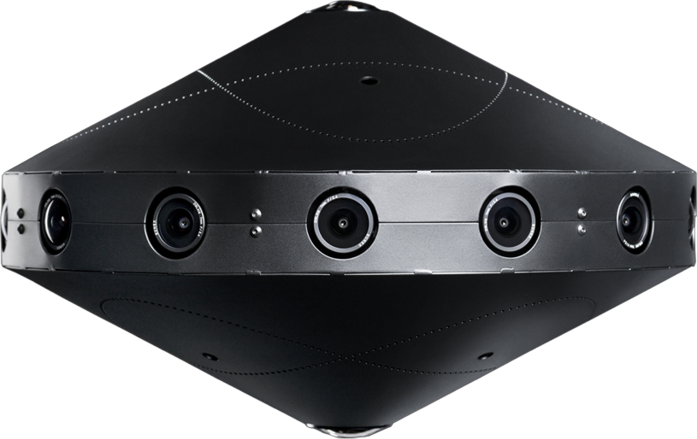
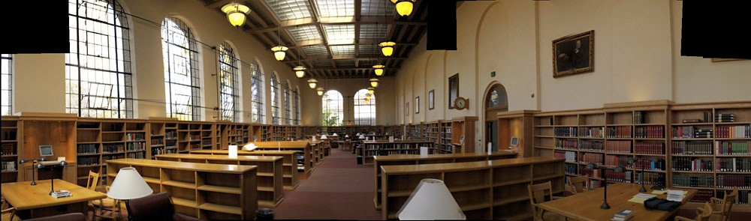
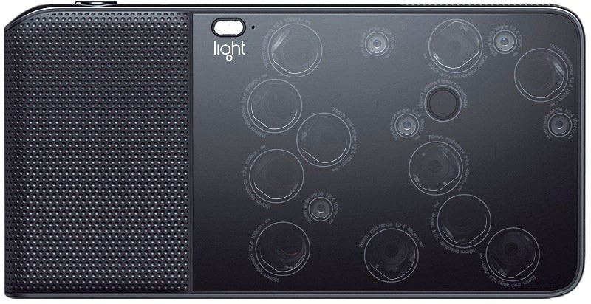

Image Processing Examples
Mosaic from 33 source images
Google Jump
facebook 360
Mosaic from 21 source images
light.co
source: M. Borgmann, L. Meunier, EE368 class project, spring 2000.

Slide 18
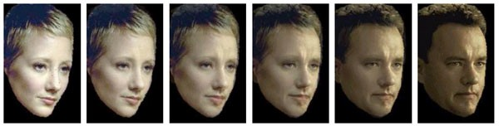
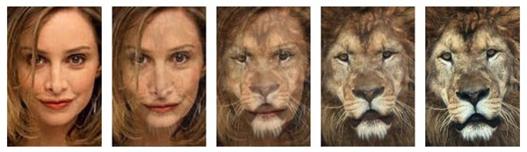
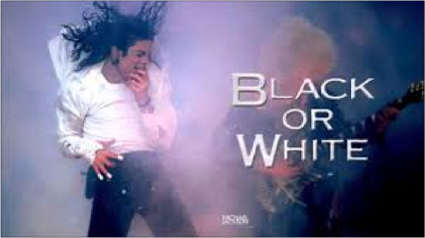
Image Processing Examples
Face morphing
Source: Yi-Wen Liu and Yu-Li Hsueh, EE368 class project, spring 2000.

Slide 19
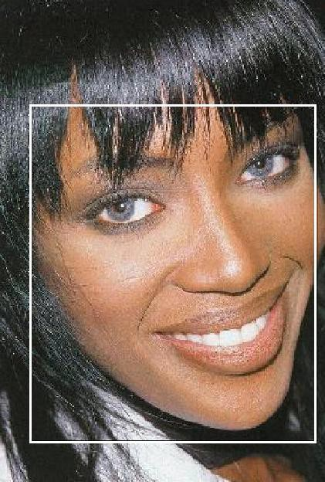
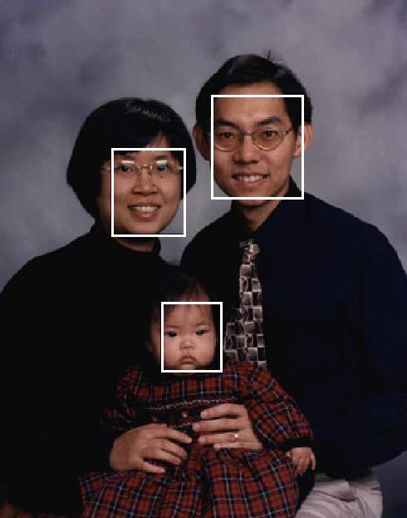
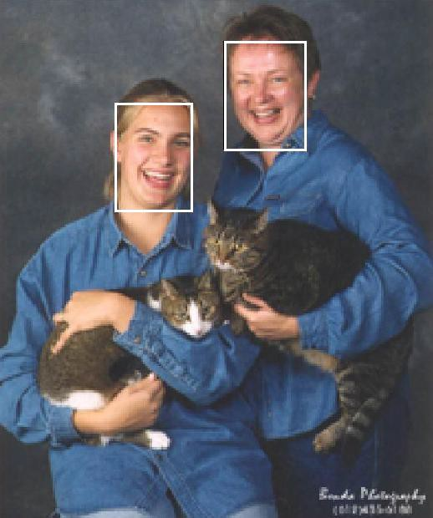
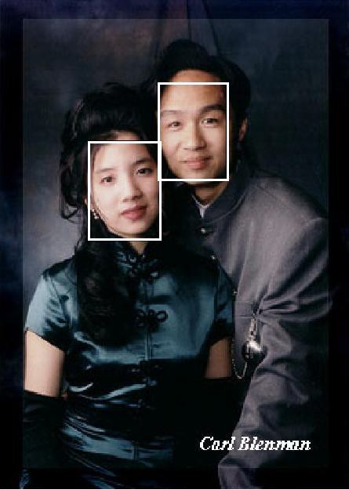
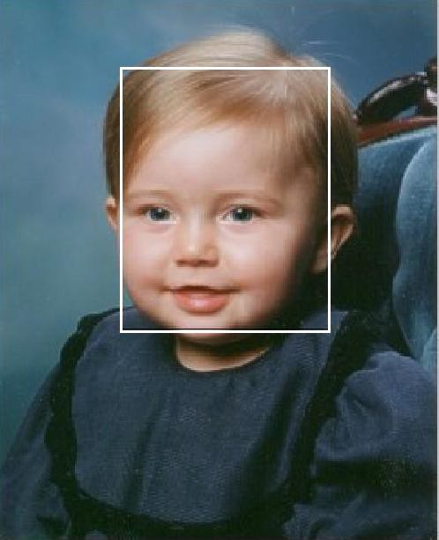
Image Processing Examples
Face Detection
source: Henry Chang, Ulises Robles, EE368 class project, spring 2000.

Slide 20
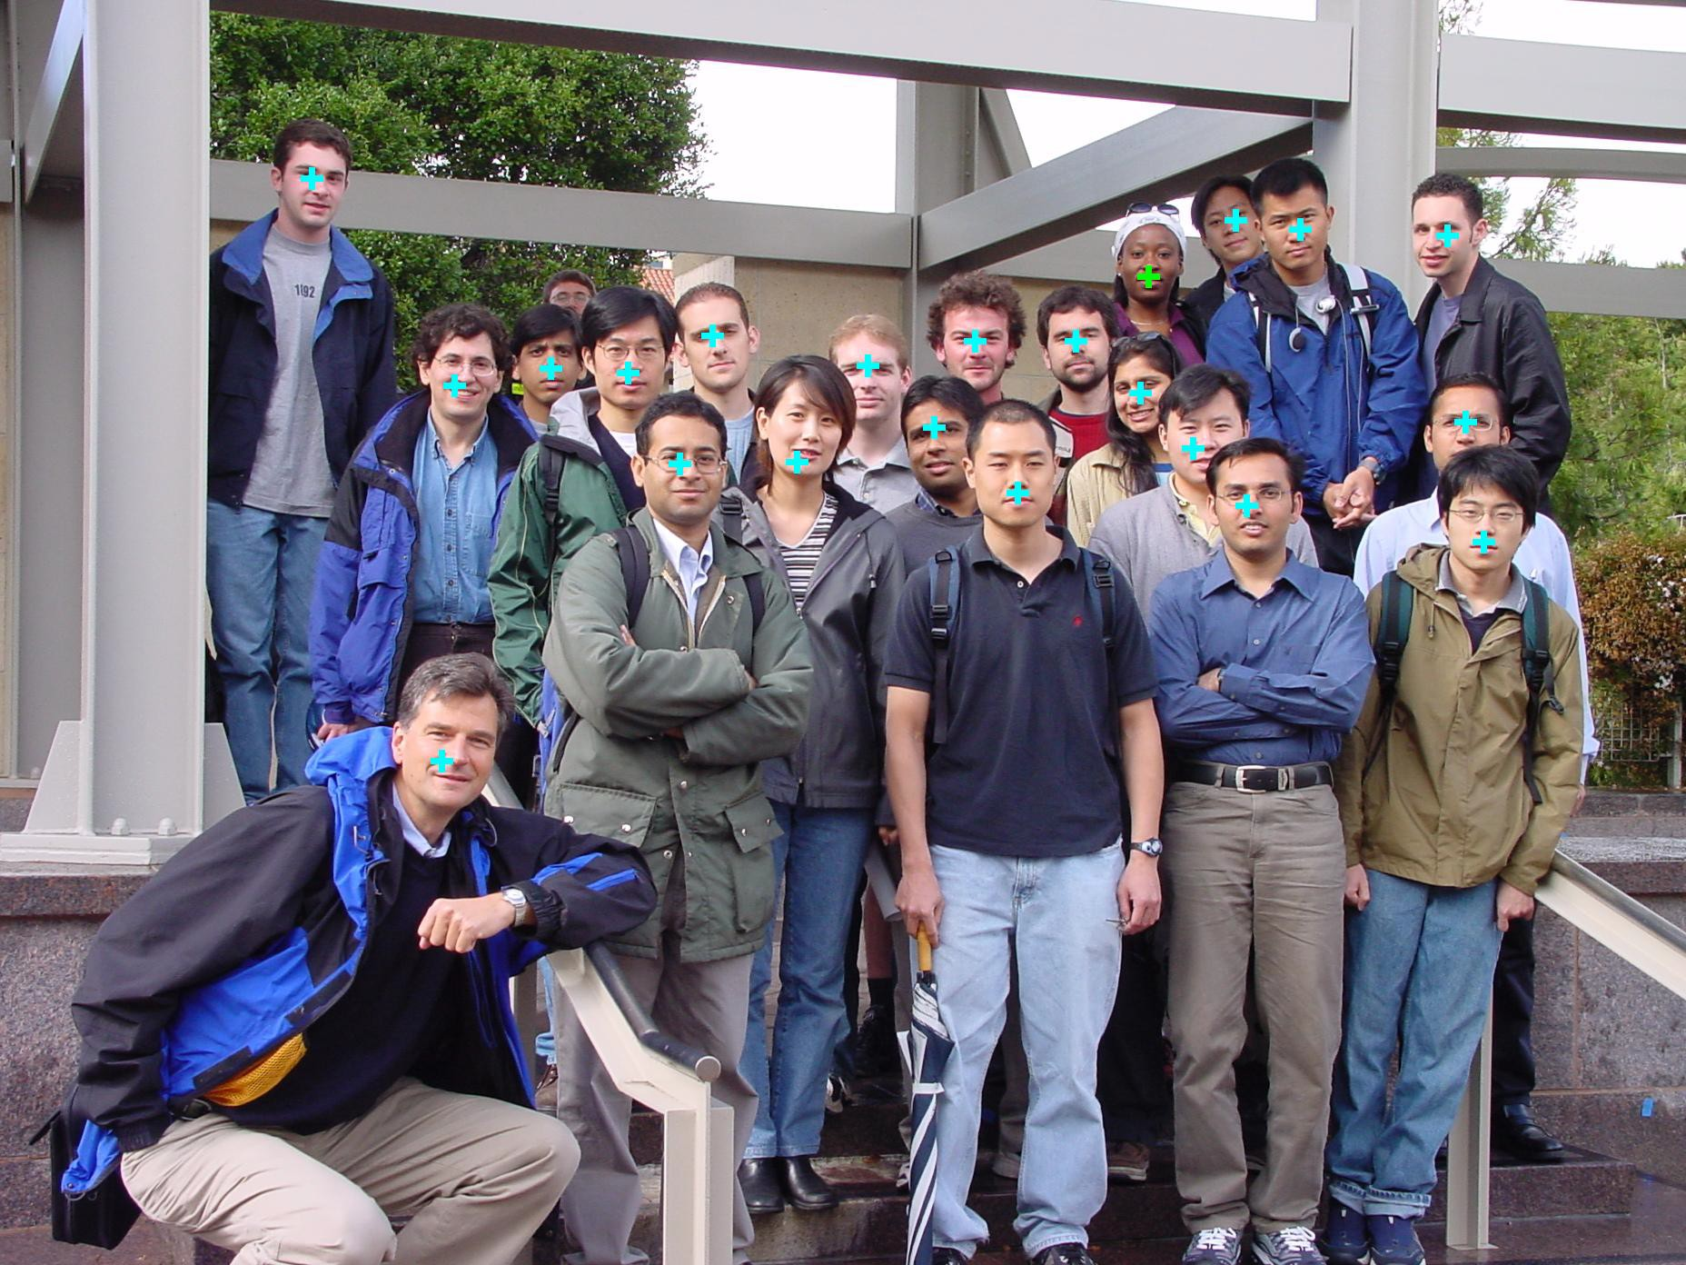
Image Processing Examples
Face Detection
source: Michael Bax, Chunlei Liu, and Ping Li, EE368 class project, spring 2003.

Slide 21
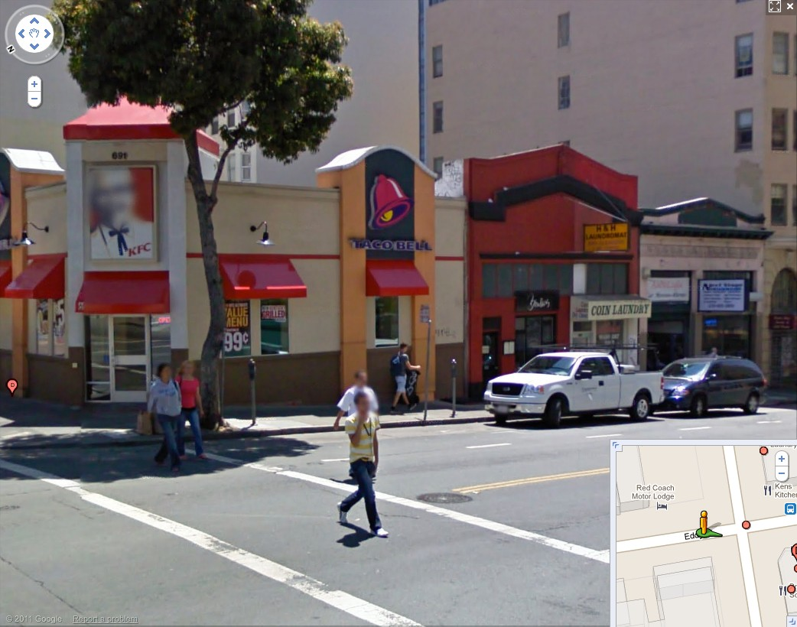
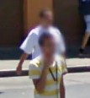

Image Processing Examples
Face Blurring for Privacy Protection

Slide 22
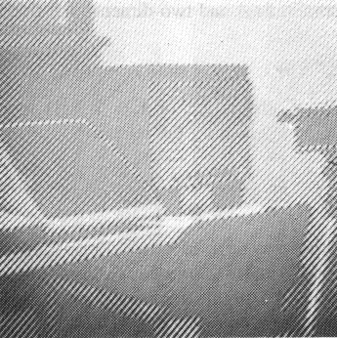
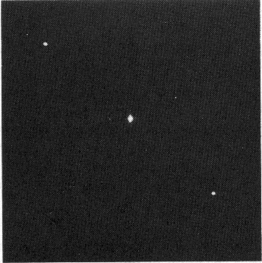
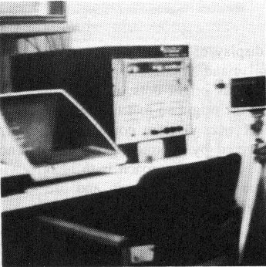
Operations in Frequency Domain
Original Noisy image
Fourier Spectrum
Filtered image

Slide 23
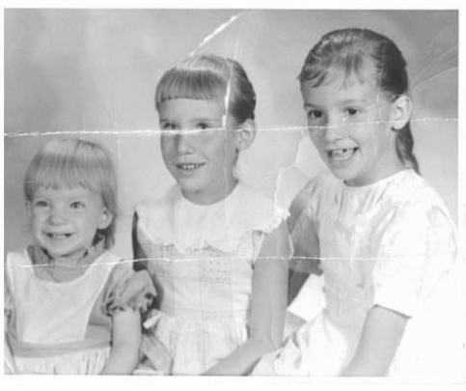

Image Inpainting 1

Slide 24
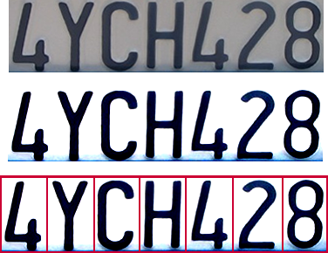

Optical character recognition (OCR)
Technology to convert scanned docs to text
If you have a scanner, it probably came with OCR software
Digit recognition, AT&T labs
http://www.research.att.com/~yann/
License plate readers
http://en.wikipedia.org/wiki/Automatic_number_plate_recognition

Slide 25
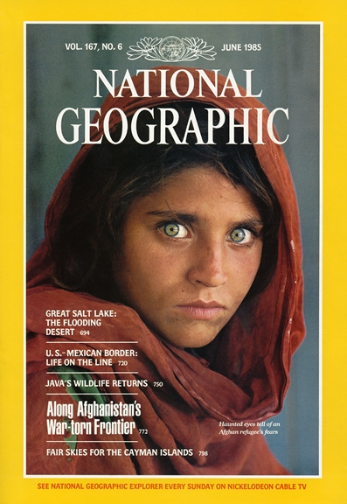
Face recognition
Who is she?

Slide 26
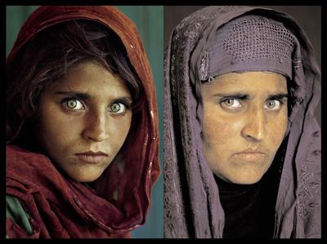


Vision-based biometrics
“How the Afghan Girl was Identified by Her Iris Patterns” Read the story
Notes:
How the Afghan Girl was Identified by Her Iris Patterns
The remarkable story of Sharbat Gula, first photographed in 1984 aged 12 in a refugee camp in Pakistan by National Geographic photographer Steve McCurry, and traced 18 years later to a remote part of Afghanistan where she was again photographed by McCurry, is told by National Geographic in their magazine (April 2002 issue) and on their website.

Slide 27




Login without a password…
Fingerprint scanners on many new laptops, other devices
Face recognition systems now beginning to appear more widely http://www.sensiblevision.com/

Slide 28


Object recognition (in mobile phones)
This is becoming real:
Microsoft Research
Point & Find, Nokia

Slide 29


Special effects: shape capture
The Matrix movies, ESC Entertainment, XYZRGB, NRC

Slide 30

Sports
Sportvision first down line
Nice explanation on www.howstuffworks.com

Slide 31

Smart cars
Slide content courtesy of Amnon Shashua
Mobileye
Vision systems currently in high-end BMW, GM, Volvo models
By 2010: 70% of car manufacturers.
Video demo

Slide 32



Challenges: viewpoint variation
Michelangelo 1475-1564
slide credit: Fei-Fei, Fergus & Torralba

Slide 33

Challenges: illumination
image credit: J. Koenderink

Slide 34

Challenges: scale
slide credit: Fei-Fei, Fergus & Torralba

Slide 35

Challenges: deformation
Xu, Beihong 1943
slide credit: Fei-Fei, Fergus & Torralba

Slide 36

Challenges: occlusion
Magritte, 1957
slide credit: Fei-Fei, Fergus & Torralba

Slide 37

Challenges: background clutter

Slide 38





Challenges: local ambiguity
slide credit: Fei-Fei, Fergus & Torralba

Slide 39

Challenges or opportunities?
Images are confusing, but they also reveal the structure of the world through numerous cues
Our job is to interpret the cues!
Image source: J. Koenderink

Slide 40

Bottom line
Perception is an inherently ambiguous problem
Many different 3D scenes could have given rise to a particular 2D picture
Possible solutions
Bring in more constraints ( or more images)
Use prior knowledge about the structure of the world
Need both exact measurements and statistical inference!
Image source: F. Durand

Slide 41


Textbook
“Digital Image Processing”,
Rafael C. Gonzalez & Richard E. Woods,
http://szeliski.org/Book/

Slide 42
Important links
https://bioimagebook.github.io/chapters/1-concepts/1-images_and_pixels/images_and_pixels.html
https://www.oreilly.com/library/view/practical-computer-vision/9781449337865/ch04.html
Recommended books:
Digital Image Processing- Rafael C.Gonzalez and Richard Eugene Woods

Slide 43

What are you looking for

